Slide 1
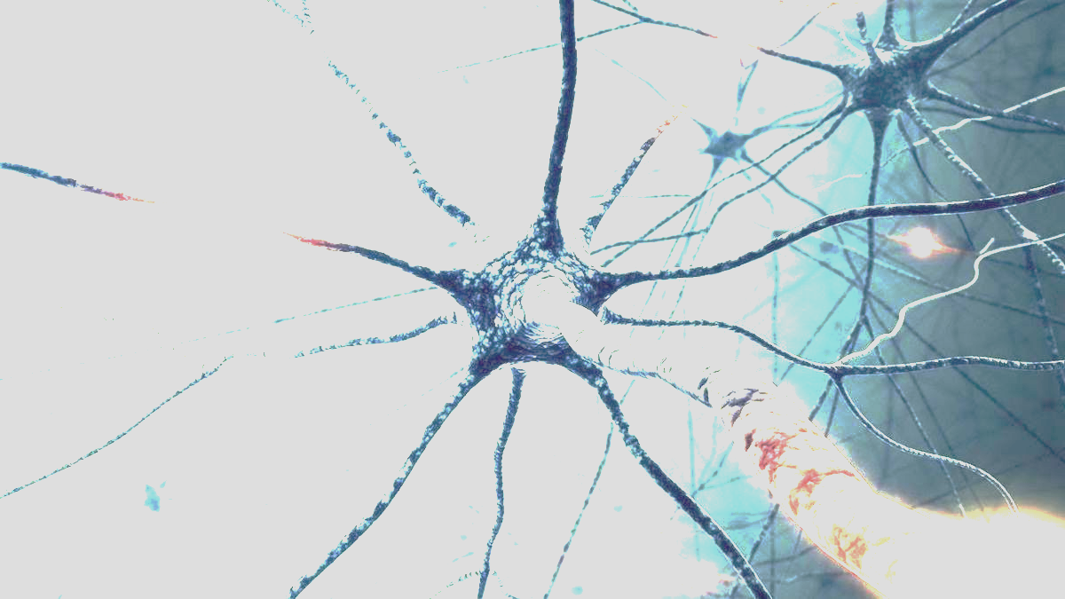
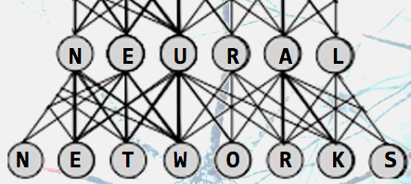
How We Tricked Rocks Into
Thinking, With Lightning
Exploring Artificial Intelligence
and Neural Networks
Antonio Caceres

Slide 2
Goals for my Independent Study
Guiding Questions:
How do neural networks work, and what determines the functions applied in the nodes?
What are the different types of neural networks and where do they work best?
What are some potential applications of neural networks?
What kinds of mental labor are humans better at than artificial neural networks?
Notes:
My goals → they filtered down into two as my independent study moved forward.

Slide 3
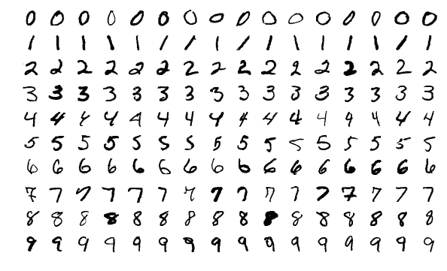



Final Project: Image Recognition
MNIST Digits
MNIST Fashion
Notes:
The goal of the final project of my independent study was to do image recognition, using two different datasets.

Slide 4
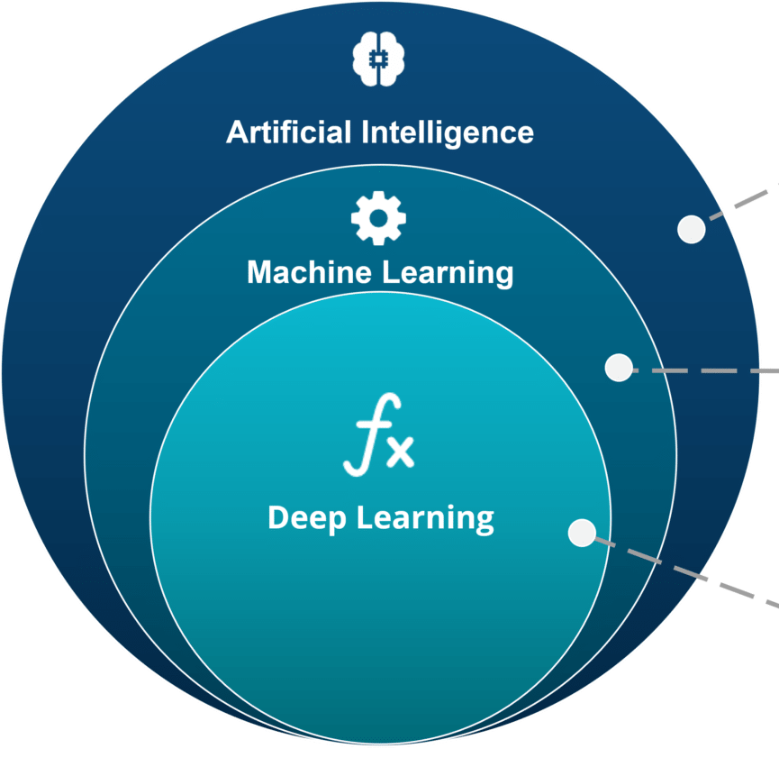
What is Deep Learning?
Artificial Intelligence
imitates human intelligence.
any modern computer program.
sense, reason, act.
Machine Learning
computer learns how to do something.
code acts as a guide for the program to learn.
Notes:
First, I’m going to talk about some of the terms associated with machine learning.
AI can imitate some aspect of human intelligence → sensing their environment, reasoning using some form of logic, acting based on that reasoning.
This term of AI includes any of the computers or computer programs that we know today. Lines of code are just instructions telling the computer how to sense, reason, and act.
When people talk about artificial intelligence today (incl. my title), they usually mean machine learning. This is the ability of a computer program to learn how to do something without the explicit instructions given by most programs. (To be clear, programs that use machine learning are still programmed, but this code no longer explicitly gives the computer instructions, instead, it gives the computer a sort of guide on how to learn. There’s another level of abstraction.
Deep learning is what I’m going to focus on in this presentation. It’s an approach to machine learning that allows the computer to build its own abstractions, to the point where even the programmer doesn’t really know how the computer does what it does. It’s a little difficult to clarify how deep learning is exactly different from machine learning on an abstract level. That’s why you don’t hear deep learning being thrown around a lot in discussions about machine learning in general. The best way to think of deep learning is a certain way to do machine learning. That way is what I’m about to talk about.

Slide 5

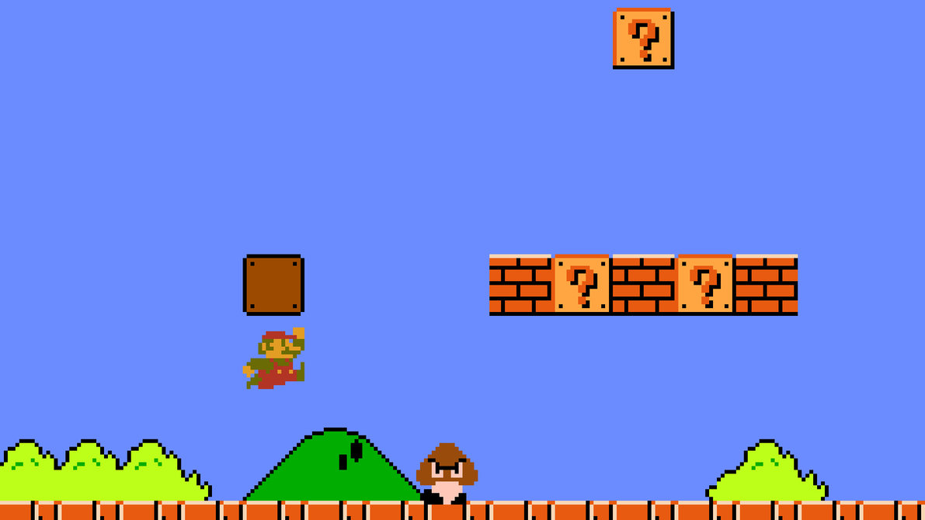
Types of Deep Learning
Supervised Learning
Reinforcement Learning
Unsupervised Learning
Give neural net an input.
e.g. an image
We tell it the right answer.
e.g. what digit is it?
Inputs over time.
Measurement with which to track its progress.
e.g. percent of level completed in Mario
It learns based on that measurement.
Used for games (board, video, etc.)
Give neural net an input.
Let the neural net decide the right answer.
Just looks for patterns.
We make sure the neural network, given a similar input, will choose the same answer.
Used for data mining, etc.
Notes:
Deep learning essentially creates an ‘artificial neural network’. I’ll talk about the structure in a bit.

Slide 6

Artificial Neural Networks
How Machines Learn

Slide 7
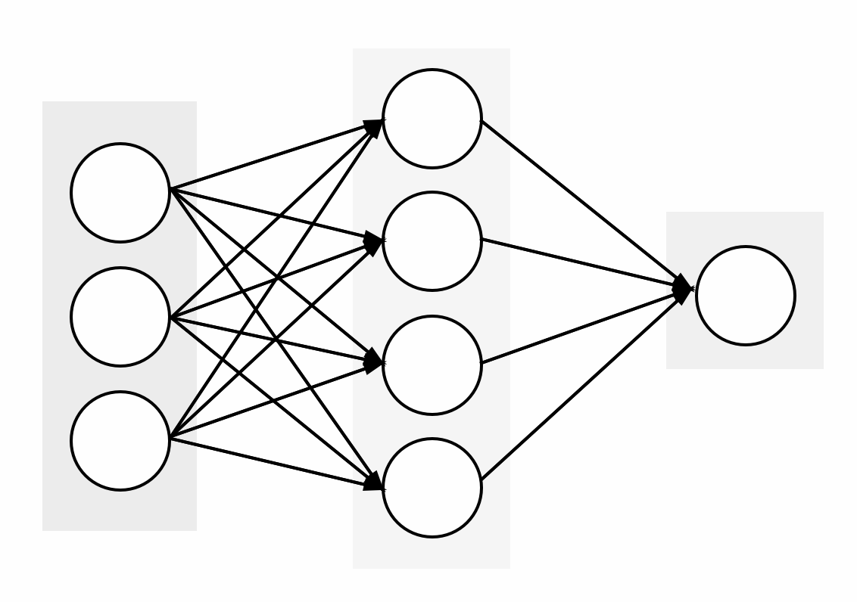
Input
Hidden
Output
Neural
Network
Pixels
The pixel is black.
1
8
The pixel is white.
0
Notes:
Structure of a neural net based on how people learn.

Slide 8
Feedforward Neural Networks
(with cookies)

Slide 9


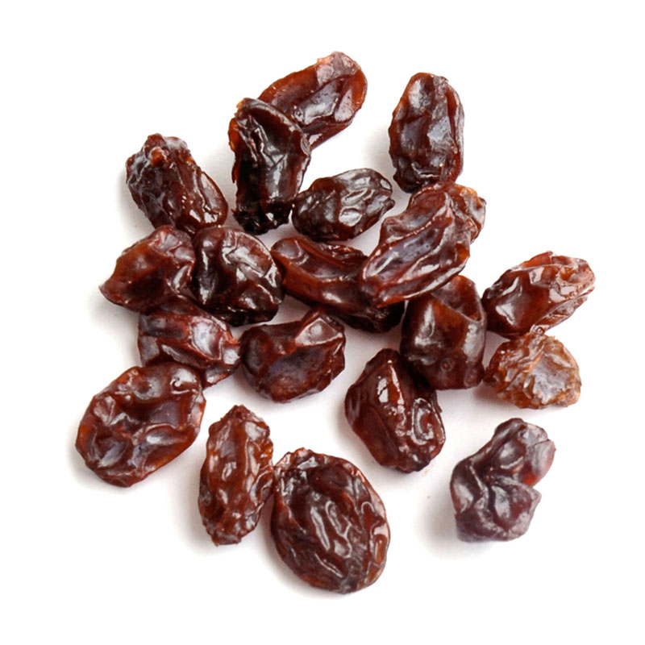
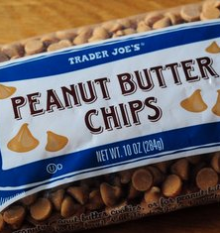
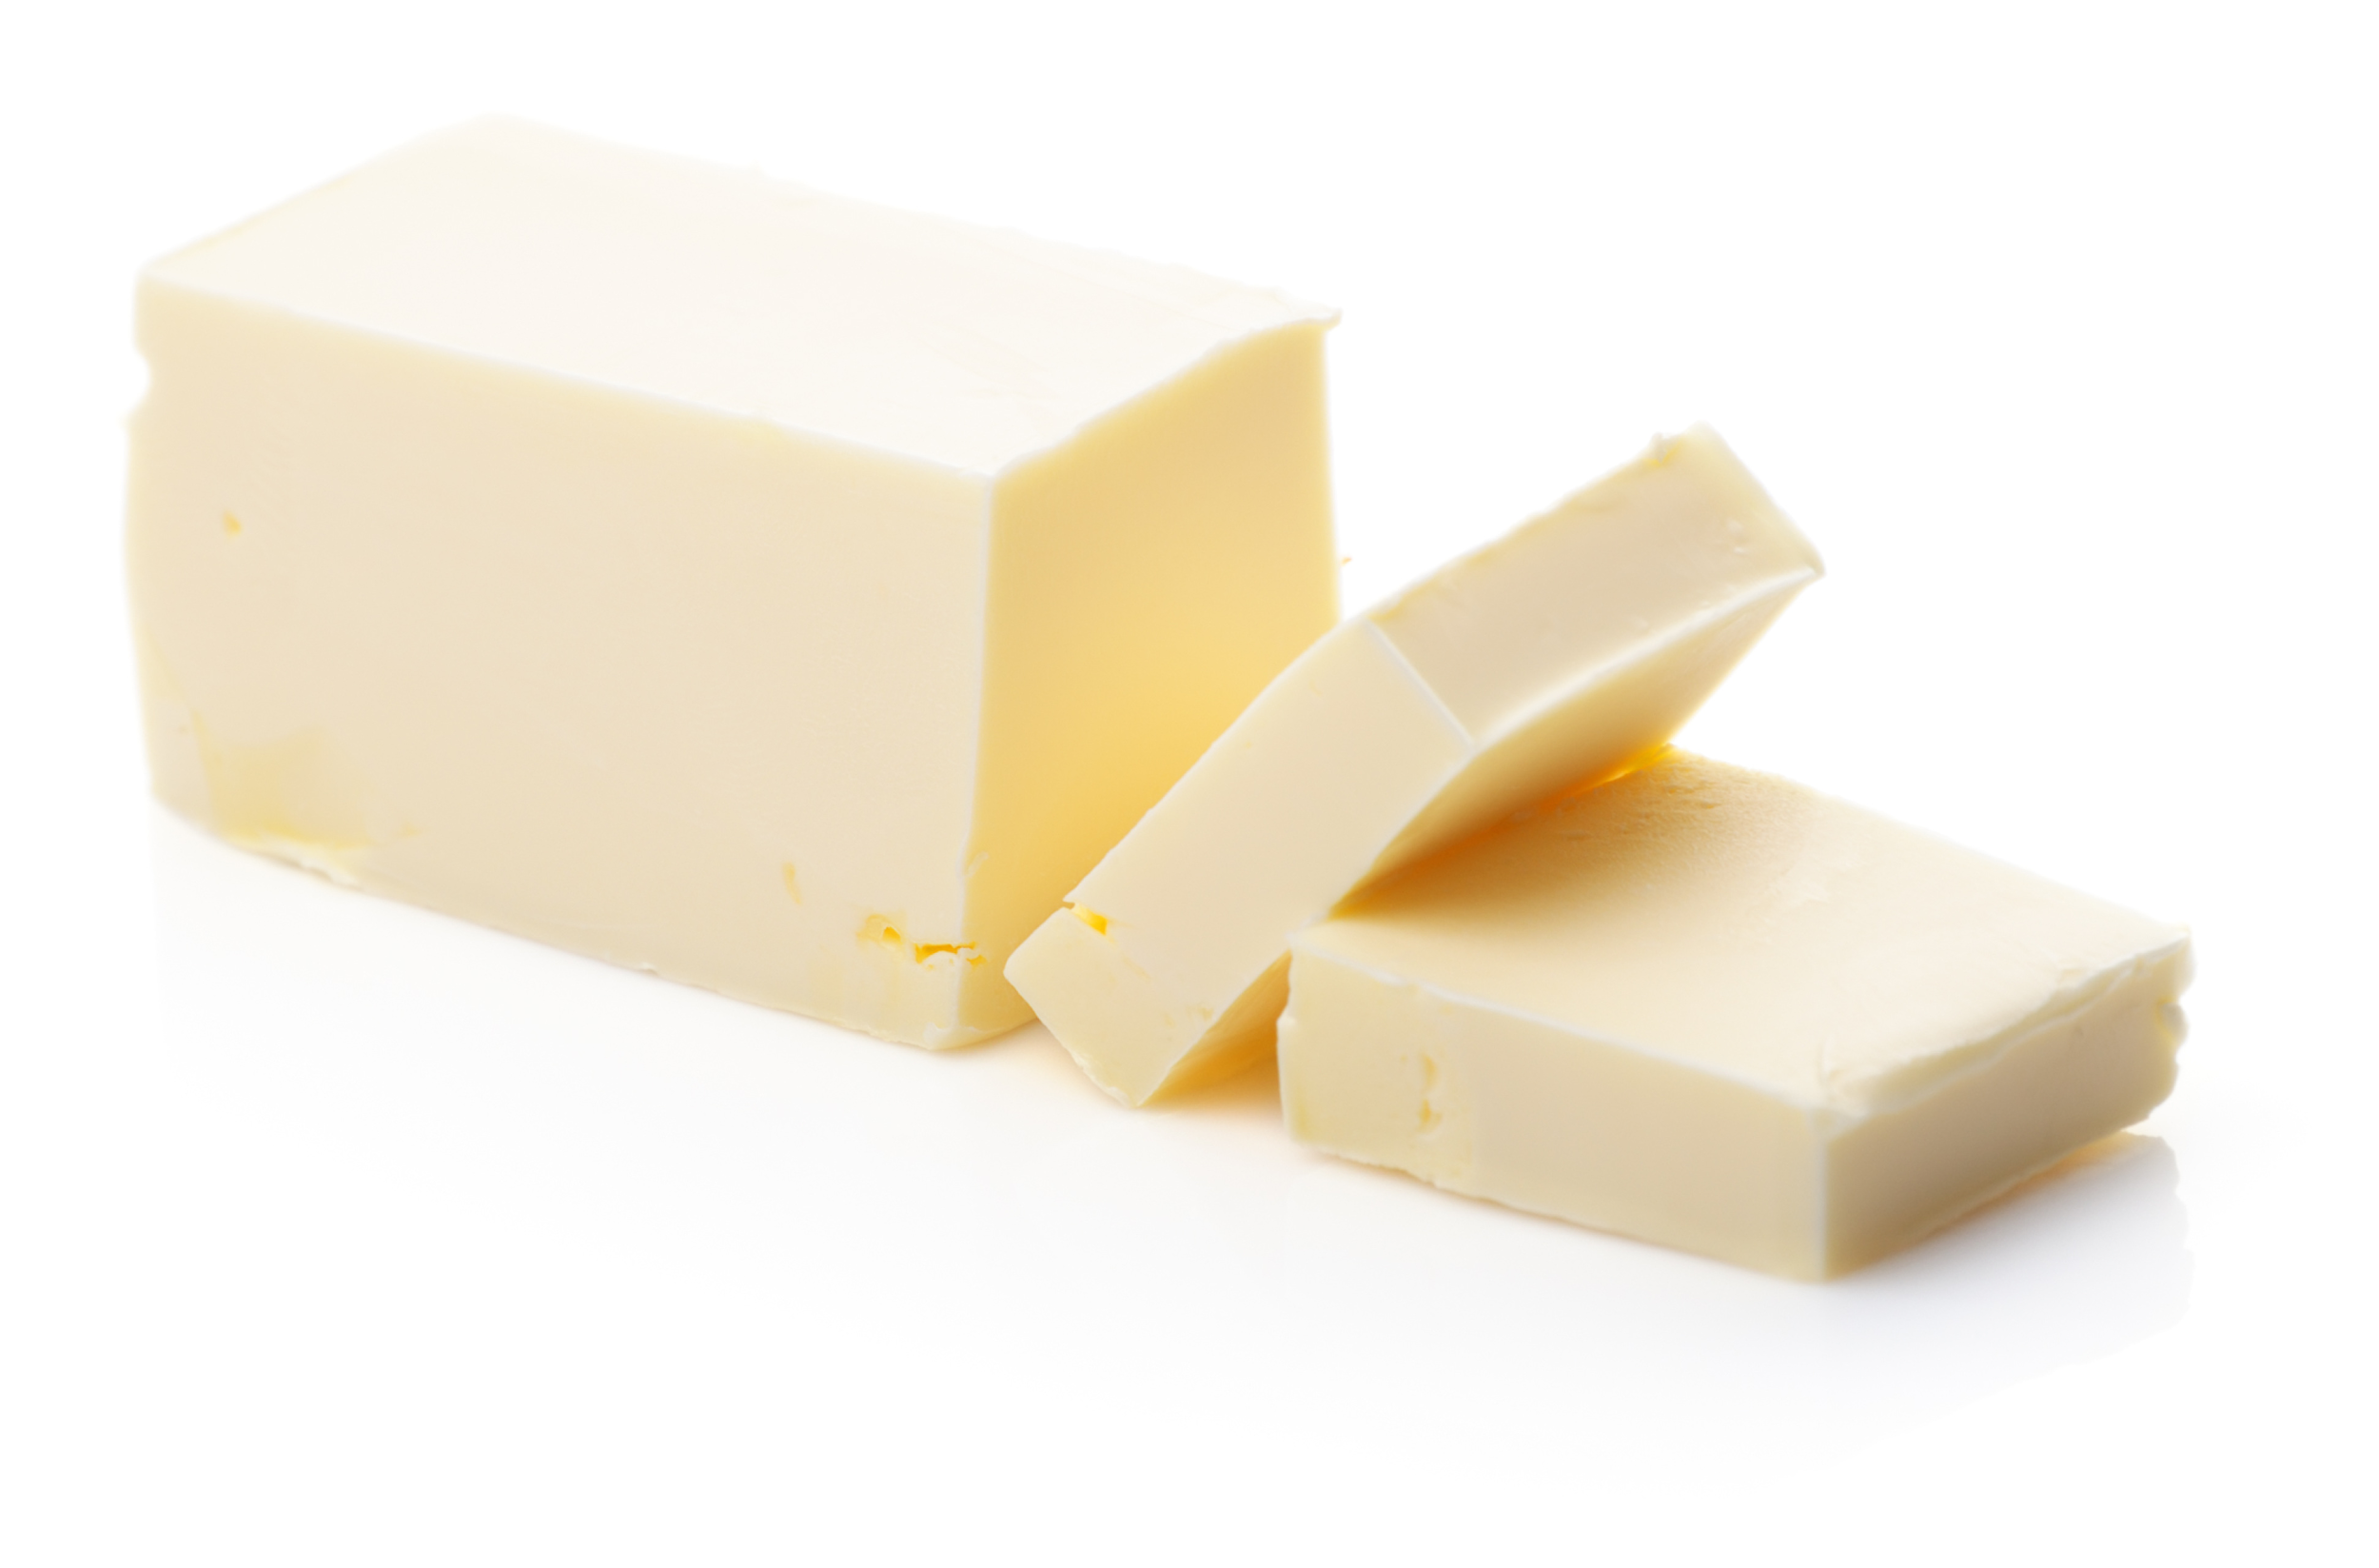
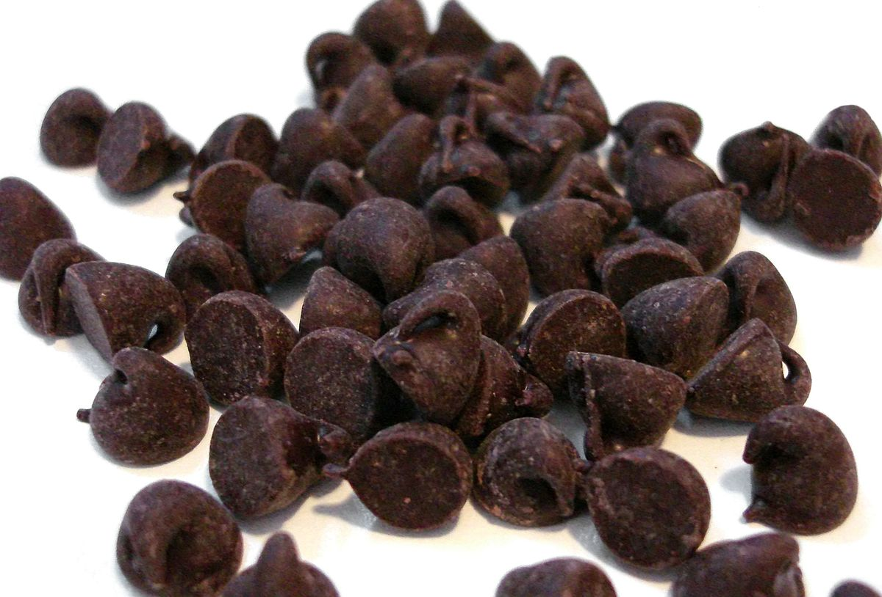
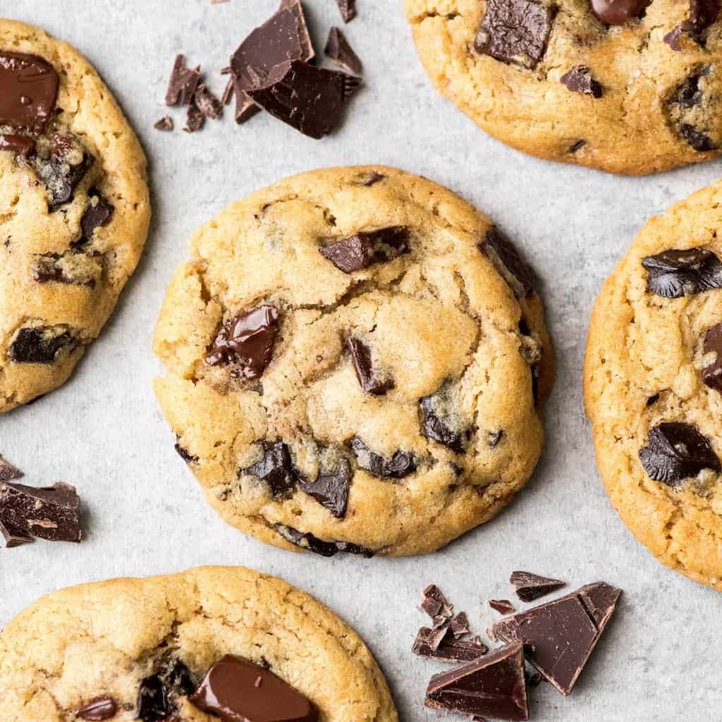
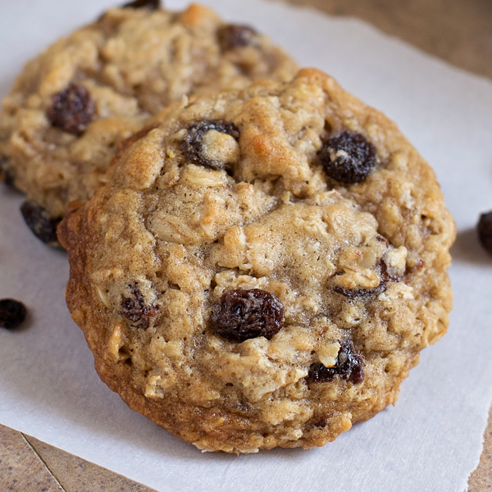
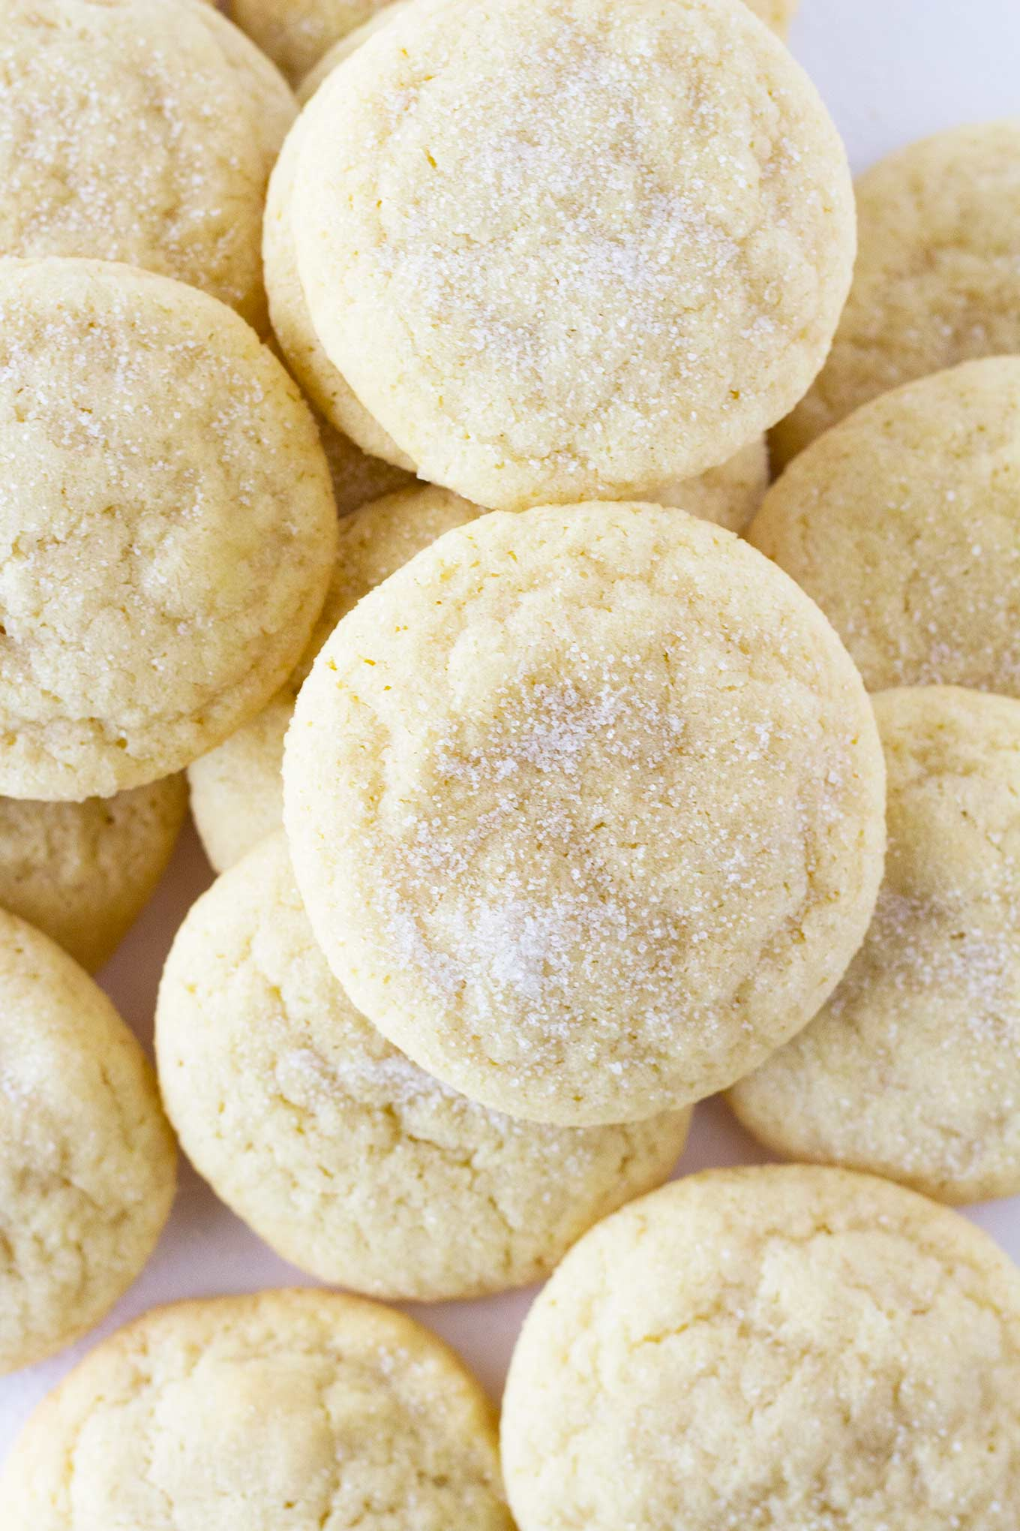
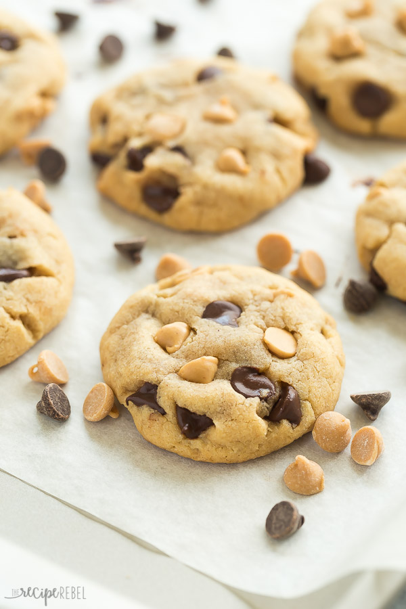
Butter and Sugar
Flour and Salt
Mix-Ins
Chocolate Chip
PB and Choc. Chip
Raisin
Sugar Cookie
Notes:
talk about the general basis for the metaphor
go into discussion about the butter and sugar mixture, and how nothing else would go in the mixture.

Slide 10
0
2
0
1
0
0
Butter and Sugar
Flour and Salt
Mix-Ins
Chocolate Chip
PB and Choc. Chip
Raisin
Sugar Cookie

Slide 11
0
Lots
0
Lots
0
Choc. Chip
PB and Choc. Chip
Mix-Ins
0
Chocolate Chip
PB and Choc. Chip
Raisin
Sugar Cookie

Slide 12
Butter and Sugar
Flour and Salt
Mix-Ins
Chocolate Chip
PB and Choc. Chip
Raisin
Sugar Cookie

Slide 13
Backpropagation
How Neural Networks Learn

Slide 14
Input
Hidden
Output
Yes / No
?
Pixels
?
1
?
8
?
0
?

Slide 15
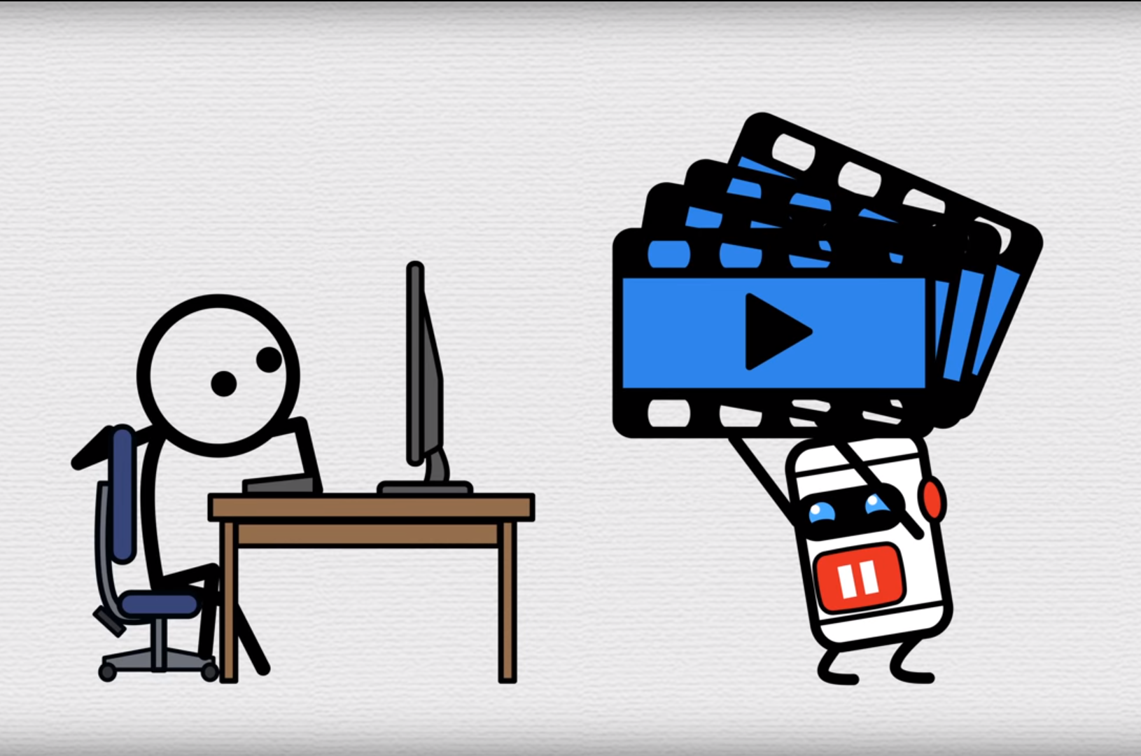
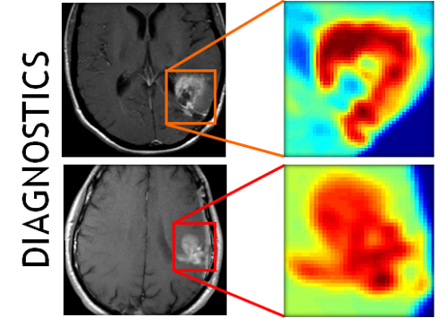
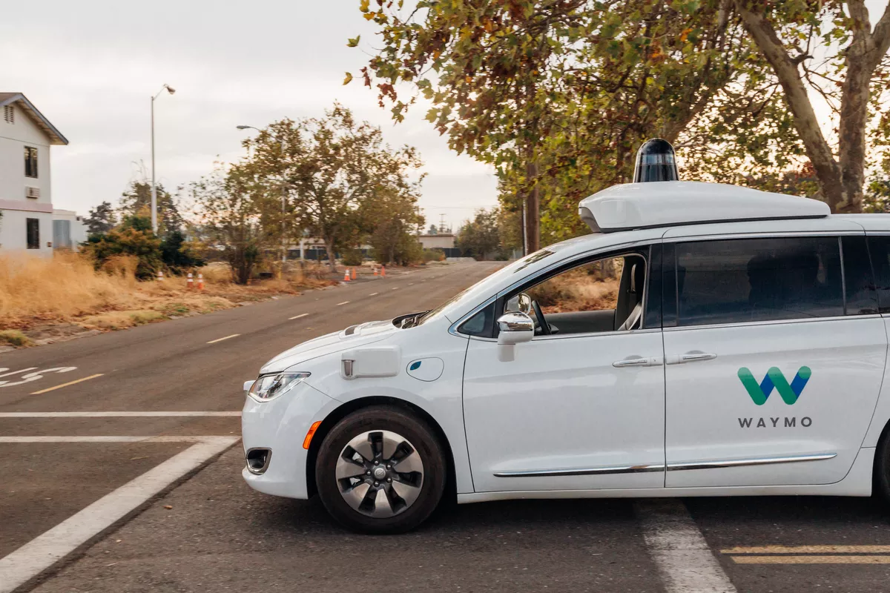
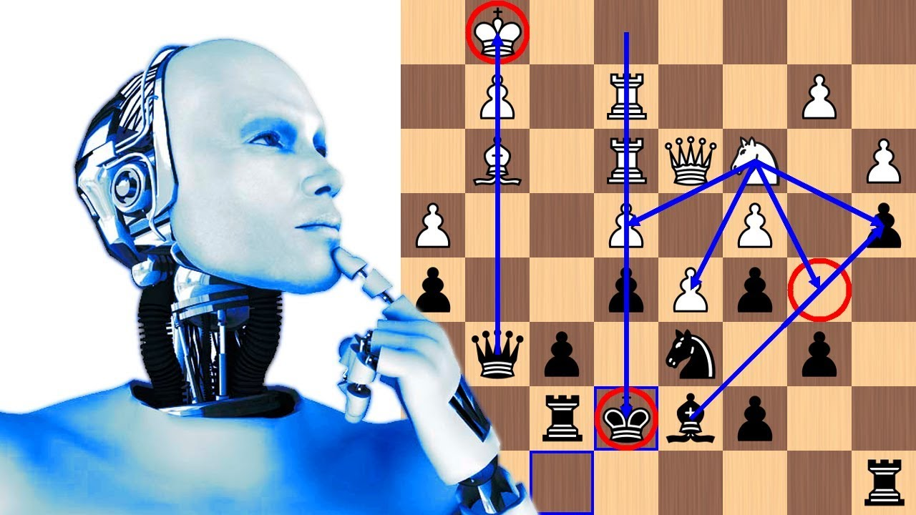
Applications of Neural Networks

Slide 16
The ‘Learning Path’
One of my projects for this Independent Study.
A ‘guide’ of resources for any interested CS student.
Book for students just coming out of AP Computer Science.
Introductory Resources + Resources to Pursue Further Projects.
On my Github (will be updated as I keep working on this project).
Email: acaceres19@shschools.org
Link: github.com/acaceres19/Independent-Study/blob/master/Resources.md

Slide 17
pyMNIST: The Final Project
Build my own neural network in Python.
Can do both handwritten digits and the fashion.
Slightly better at digits.
Simple drawing app to recognize digits in real time.
Notes:
What should I focus on in this slide?

Slide 18
DEMO!
Questions?

Slide 19

Challenges with Data and Augmentation
Processing 28x28 pixel images.
Images in the digit dataset were mostly drawn in the center.
Trained neural network didn’t really know about pixels along the edge.
Program to move the image around to different permutations.
e.g. all the way to the left, at the top, random, etc.
Notes:
CHALLENGES SLIDE!

Slide 20
Input
Hidden
Output
Yes / No
Math of
a Neural
Network
Partial
Derivatives
(cost function with respect to weight)
Pixels
1
8
Cost Function
(how wrong the network is)
0
Notes:
MATH SLIDE

